Slide 1
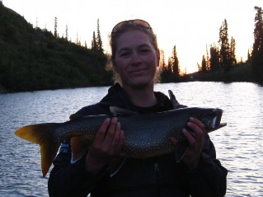
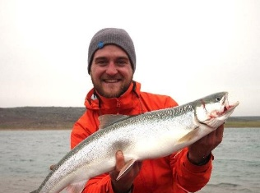
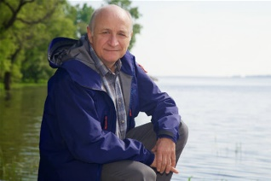
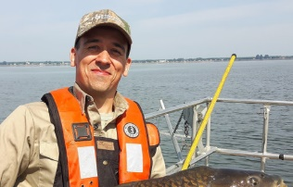
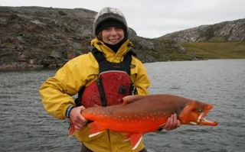
Come join our team!
MSc and PhD positions in freshwater fish ecology & alpine lakes (Norway and Canada)
Louise Chavarie
The Norwegian University of Life Sciences
Jean-Sébastien Moore
Université Laval
Pierre Magnan
UQTR
Olivier Morisette
MFFP
Heidi Swanson
University of Waterloo
Winter and summer aquatic ecology
We are recruiting PhD and MSc students to examine fish winter and summer ecology in the Chic-Chocs Mountains (Québec, Canada), linking ecologial, behavioural and evolutionary drivers of fish life-cycle in alpine lakes. The project is co-led by the Mi'gmaq organization MMAFMA on whose traditional territories this work takes place. It is funded by the Canadian Mountain Network (www.canadianmountainnetwork.ca) and is done in collaboration with provincial government agencies (MFFP & SÉPAQ). Fish species studied will include Arctic charr, lake trout, and brook trout and key approaches include genomics, eDNA, morphology, telemetry, isotopes, fatty acids, otoliths, food-web ecology.

Slide 2
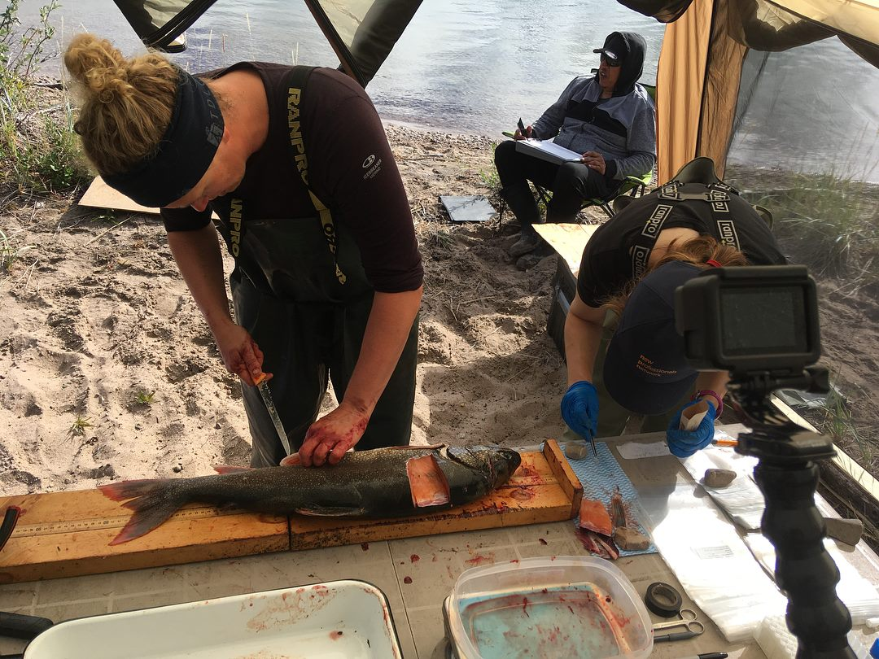
Come join our team!
Application deadline: October 1, 2021
Skills and experience: Ideally, candidates will have previous research experience with fish ecology, molecular biology, population genetics, statistics, and/or field work in alpine/remote locations. Knowledge of french is an asset for some positions but not required. Indigenous applicants will be given priority.
Start date: January 2022 but negotiable
Location: Université Laval (PhD & MSc positions) and The Norwegian University of Life Sciences (PhD position).
Submission process: All documents must be submitted to Louise Chavarie (louise.Chavarie@nmbu.no)
Cover letter demonstrating fit and interests in the positions described above
Current CV demonstrating relevant research experience and background
Names/contact information for two references
We are committed to foster a culture of inclusion. The project CREA_CC invites and encourages applications from all qualified individuals, including from groups that are traditionally underrepresented in employment (especially indigenous students because the co-leader of this project is MMAFMA), who may contribute to further diversification of our team.
Notes:
All qualified applicants are encouraged to apply; however, indigenous students will be given priority.

